Slide 1
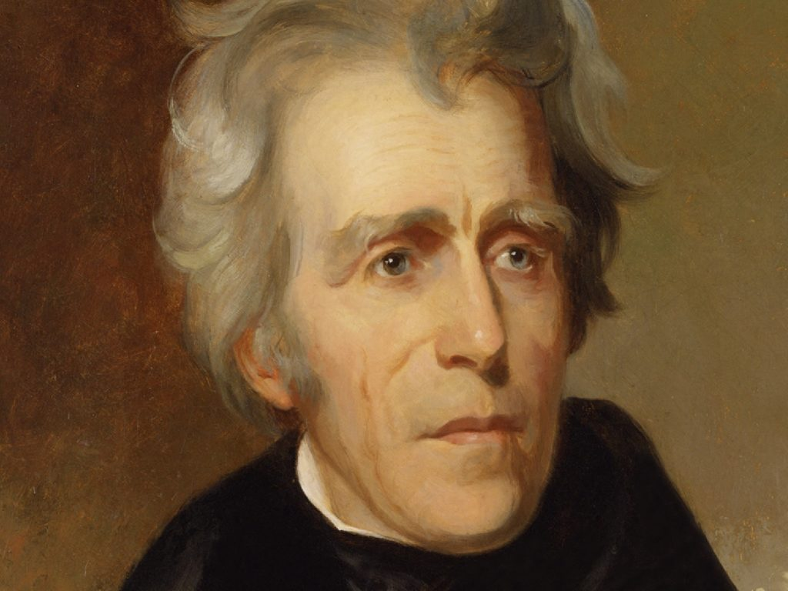
Andrew Jackson
The People’s Choice

Slide 2
Andrew Jackson was our first Irish-American president.
Others included William Henry Harrison, Abraham Lincoln, Ulysses S. Grant, John F. Kennedy, Ronald Reagan, Bill Clinton, and Barack Obama!

Slide 3
Andrew Jackson’s father died before he was born.

Slide 4
Jackson won the election of 1828 with most of his support coming from the West and the South.

Slide 5
20,000 Jackson supporters had a party in the White House to celebrate his inauguration, and they caused a lot of damage!

Slide 6
Jackson defeated the Creek (“Red Stick”) Indians at the Battle of Horseshoe Bend
The Creeks had been attacking American settlements in Mississippi Territory, and Jackson and his men were sent in to put a stop to it.
He did, but he got the reputation as an “Indian Killer.”

Slide 7
Jackson’s presidency marked the beginning of a new and more democratic era in political life.
Democracy means “the people rule,” so a more democratic era means more people start participating in political life.

Slide 8
Jackson called the Second Bank of the United States “The Monster.”

Slide 9
An action by a state that cancels a federal law to which the state objects is called “nullification.”

Slide 10
Jackson signed a federal law called the Indian Removal Act of 1830.
Tensions between Native Americans and American settlers had been increasing in the southwest.
He said that he wanted to move the Indians west of the Mississippi River because he thought they would be safer there.

Slide 11
During the Revolutionary War, Andrew Jackson and his brother, Robert, became scouts for the Patriot army.
They were captured by the British, and were held as prisoners on a British prison ship.

Slide 12
Andrew Jackson started a new political party called the Democratic Party.
This was the beginning of the modern-day Democratic Party. Some people still call it the “party of Jackson.”

Slide 13
In the election of 1824, Jackson ran against John Quincy Adams, Henry Clay, and William H. Crawford. He won the popular vote and electoral vote, but not a majority, so the House of Representatives had to decide the election. Henry Clay got his friends to vote for Adams in exchange for being appointed Adams’ Secretary of State. Jackson claimed the two men had made a “corrupt bargain.”

Slide 14
The Five “Civilized” tribes of Indians that were removed from their lands in the southeast included the Choctaws, Chickasaws, Cherokees, Creeks and Seminoles.

Slide 15
Jackson was a Warhawk leading up to the War of 1812.
This means that as a congressman, he was eager for the United States to declare war on England.

Slide 16
Jackson believed that the Bank made rich people richer at the expense of the poor.

Slide 17
Once he grew out of his teenage years, Jackson studied to become a lawyer.

Slide 18
While on the British prison ship, a British officer told Andrew to clean his boots. When Andrew refused, the officer slashed him in the face with his sword. It left permanent scars on his face and hand, and left him with a hatred of the British.

Slide 19
Jackson was the first president to ever ride a train.

Slide 20
The Creeks gave Andrew Jackson the nickname “Sharp Knife.”
They probably called him that because he was deadly, cold, and unyielding.

Slide 21
South Carolina voted to nullify a tariff and threatened to secede (leave) from the Union during Jackson’s presidency.

Slide 22
Jackson fell in love with a woman named Rachel Donelson, and married her, but it turned out that her divorce from her first husband was never finalized!
Rachel had left her first husband because he had been abusive to her. She thought her ex-husband had filed the divorce papers, but he hadn’t!
Just being divorced back then was considered scandalous, especially for a woman, who was considered “used merchandise.” But Andrew loved her anyway!

Slide 23
After Jackson took over Florida, Spain offered to cede the territory to the U.S., because they knew we could take it over whenever we wanted.
Jackson was named Governor of the Florida Territory
That’s why one of the biggest cities in Florida is Jacksonville!

Slide 24
Andrew Jackson was born in a log cabin somewhere between North Carolina and South Carolina.

Slide 25
Jackson bought a cotton plantation near Nashville called “The Hermitage.” He also started to buy slaves to pick the cotton.

Slide 26
Jackson won the Battle of New Orleans at the end of the War of 1812 and became a national hero!

Slide 27
The 20-year period after Jackson became President is known as the “Age of Jackson.”

Slide 28
Soldiers fighting with Andrew Jackson gave him the nickname “Old Hickory” because he was so tough!
After the Battle of Horseshoe Bend, Jackson gave up his horse to some wounded soldiers could ride, even though he was exhausted and had dysentery ( diarrhea.) He walked hundreds of miles back to Tennessee.
Wood from hickory trees is tough and hard to bend.

Slide 29
Andrew and Robert both caught the deadly disease smallpox while being held by the British. Robert died from smallpox, but Andrew survived.

Slide 30
Rachel’s reputation was “stained” by being divorced, and married to two men simultaneously.
This information will be used against Andrew Jackson when he runs for President! The election turned ugly, with insults and exaggerations being written about both candidates.

Slide 31
“Nullification” is the idea that a state could refuse to enforce any federal law to which it objects.

Slide 32
Andrew Jackson and his wife Rachel are buried at his home, The Hermitage, in Tennessee.
At Jackson’s funeral, his pet parrot had to be taken away because it was cursing too much!

Slide 33
The routes used to march the Native Americans to Indian Territory are called “The Trail of Tears.”

Slide 34
John C. Calhoun supported South Carolina’s idea to secede from the Union, and he resigned from being Vice President during the nullification crisis.

Slide 35
Andrew Jackson said, “the Bank is trying to kill me, but I will kill it!”

Slide 36
Throughout the presidential campaign of 1828, the Adams campaign wrote terrible things about Rachel in newspapers. One month after Jackson won, Rachel died. Jackson blamed the Adams campaign, saying, “May God Almighty forgive her murderers, as I know she forgave them. I never can!”
After Rachel died, Jackson wore a locket with her picture inside, and slept with it on the pillow next to his every night. He never remarried.

Slide 37
Jackson was sent to Florida by President Monroe, to recapture escaped slaves who had joined the Seminole Nation. He burned their villages and crops, and forced the Spanish governor to flee.
Henry Clay criticized his actions in Congress.

Slide 38
Thousands of supporters poured into Washington, DC for Jackson’s inauguration, which they saw as a victory for the common man.

Slide 39
Jackson’s mother died of cholera, and he was orphaned at the age of 14.
Think what it would be like to be orphaned at 14. You would have to take care of yourself. People would try to take advantage of you. You would have to toughen up and learn to fight!

Slide 40
Jackson spent much of his teenage years drinking, gambling on horses, and fighting.
He inherited some money from his grandfather in Ireland, and wasted it all betting on a horse race.
He didn’t have anyone teaching him right from wrong.

Slide 41
The two anti-Jackson parties were the National Republicans, and later, the Whigs.

Slide 42
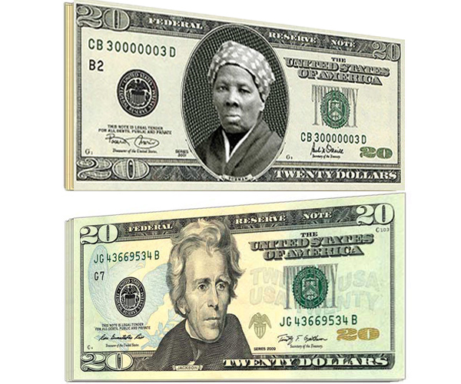
Andrew Jackson’s face is on the $20 bill.
In 2016, Congress said they would be taking his face off, and putting Harriet Tubman’s face on.
It hasn’t happened yet.

Slide 43
After the Election of 1824, Jackson hated the Electoral College, and thought that the popular vote should be used to choose the president.

Slide 44
Jackson and his supporters did not trust the government, and were suspicious of banks, which they thought favored the rich.

Slide 45
Jackson fought many duels in his life, with people who insulted him or his wife. When he was President, he had several bullets lodged in his body.
Charles Dickinson made bad remarks about Rachel, so Jackson challenged him to a duel. Dickinson shot Jackson in the chest, and the bullet lodged near his heart, but Jackson didn’t even flinch! He took careful aim and shot and killed Dickinson.

Slide 46
Jackson was elected to two terms as president, in 1828 and 1832. He was president from 1829-1837.
Even though a president is elected in November, he doesn’t officially start until January of the next year. For example, the candidate elected this November will be elected in 2020, but their term of office doesn’t begin until January 20, 2021.

Slide 47
Jackson chose to veto the renewal of the Bank’s charter, which later caused an economic crisis.
Martin Van Buren would be held responsible for the Panic of 1837, and would only be a one-term President.

Slide 48
Rachel and Andrew Jackson adopted a Creek Indian boy named Lyncoya, who was found alive after a battle. They raised him as their son.
Sadly, he died when he was 16 years old, as he was about to go to West Point Military Academy to be a soldier like Andrew.
People sometimes call Andrew Jackson a racist, but I wonder if a racist would adopt a Native American?

Slide 49
When the Cherokees won their Supreme Court Case, Jackson said, “John Marshall has made his decision – now let him enforce it!”
This means that Jackson wouldn’t enforce it, so the Cherokees lost their lands and had to move to Indian Territory.
What job does the executive branch have? Enforcing federal laws!

Slide 50
In the Age of Jackson, nominating conventions began to be used to choose candidates for office.
This means “regular people” got to participate in choosing candidates, rather than a small group of legislators.

Slide 51
Opponents of Jackson described the White House inauguration party as “ the reign of King Mob.”

Slide 52
Jackson supporters believed that ordinary people should get to vote and hold public office.

Slide 53
Jackson was the first President to become the target of an assassination attempt.
A disgruntled painter confronted Jackson on the steps of the Capitol Building and pulled-out a gun. He pulled the trigger, but it didn’t fire! He pulled out a second gun, and it jammed, too! Jackson then beat the man over the head with his cane until he was pulled-off him!
They tested both guns later. They worked fine! Was he “protected” like George Washington???

Slide 54
When elected in 1828, Jackson replaced about 20% of federal officeholders with his supporters. His opponents thought that was wrong, and called it the “Spoils System.”

Slide 55
The tribes that lost their lands were forced to walk to Indian Country, which today is known as Oklahoma.
Many tribes still have reservations in Oklahoma.
My Oklahoma license plate says, “Native America” on it.

Slide 56
Andrew Jackson rode a horse to his inauguration. He wanted to appear like a general.

Slide 57
His enemies called Jackson “King Andrew” after he killed the Bank, because they thought he had made the presidency too powerful.

Slide 58
Jackson died in 1845.
Scientists wondered what he died of, and just a few years ago exhumed his body and tested it. The results said he died of lead poisoning, probably from all of the lead bullets he had in his body from the duels!
As he lay near death, he was asked if he had any regrets. He said, “I regret that I didn’t shoot Henry Clay, and that I didn’t hang John C. Calhoun!”

